Slide 1
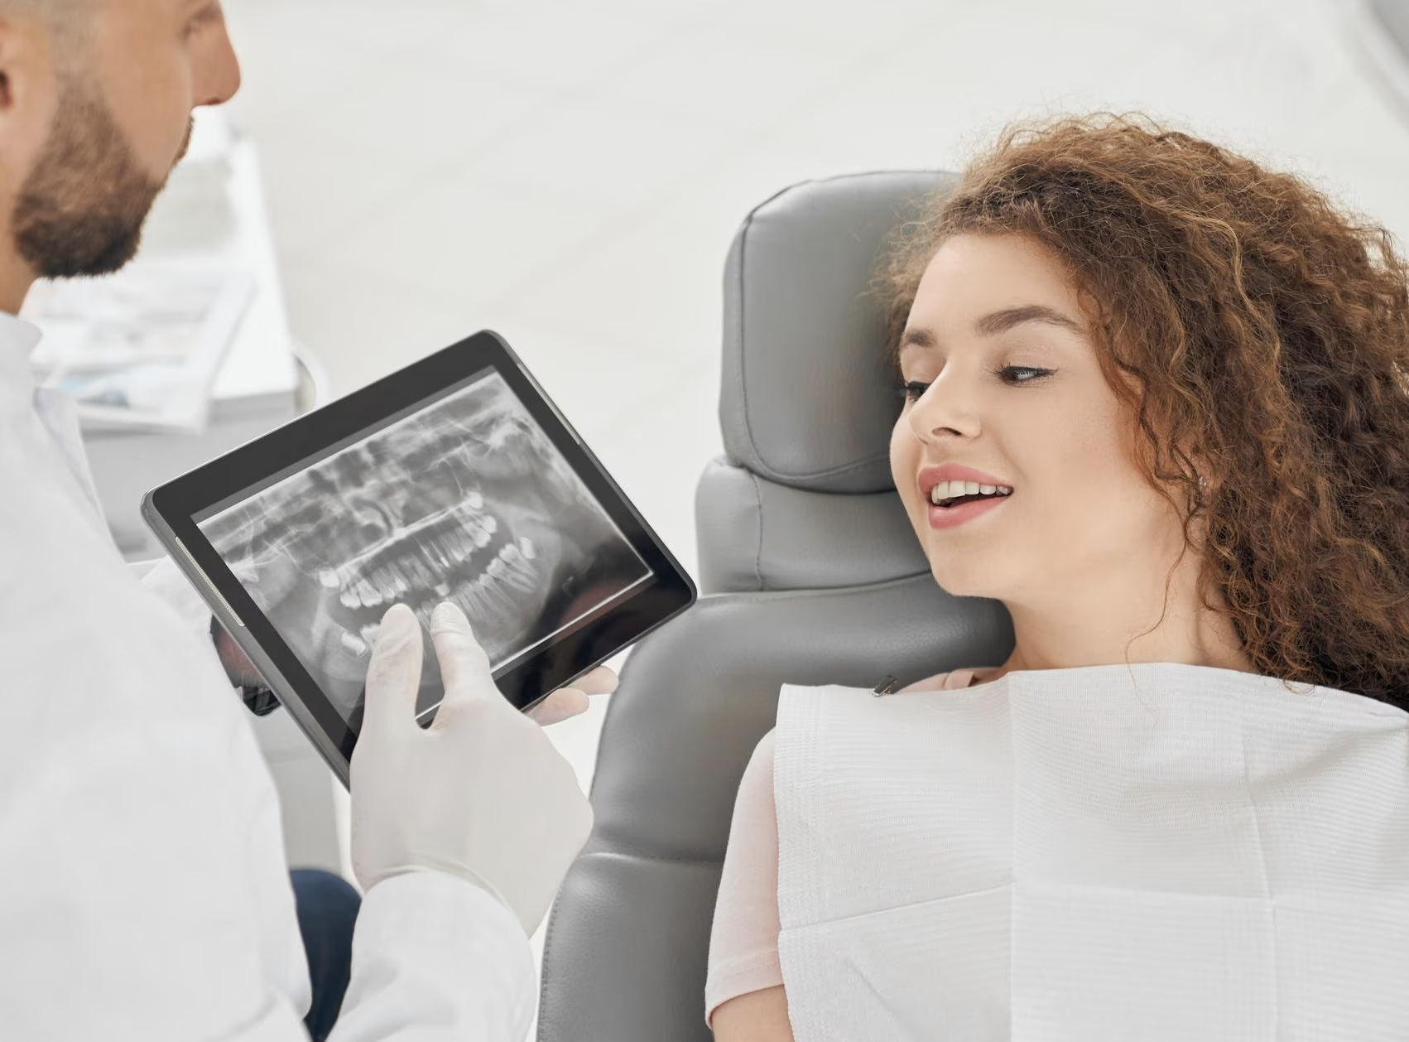
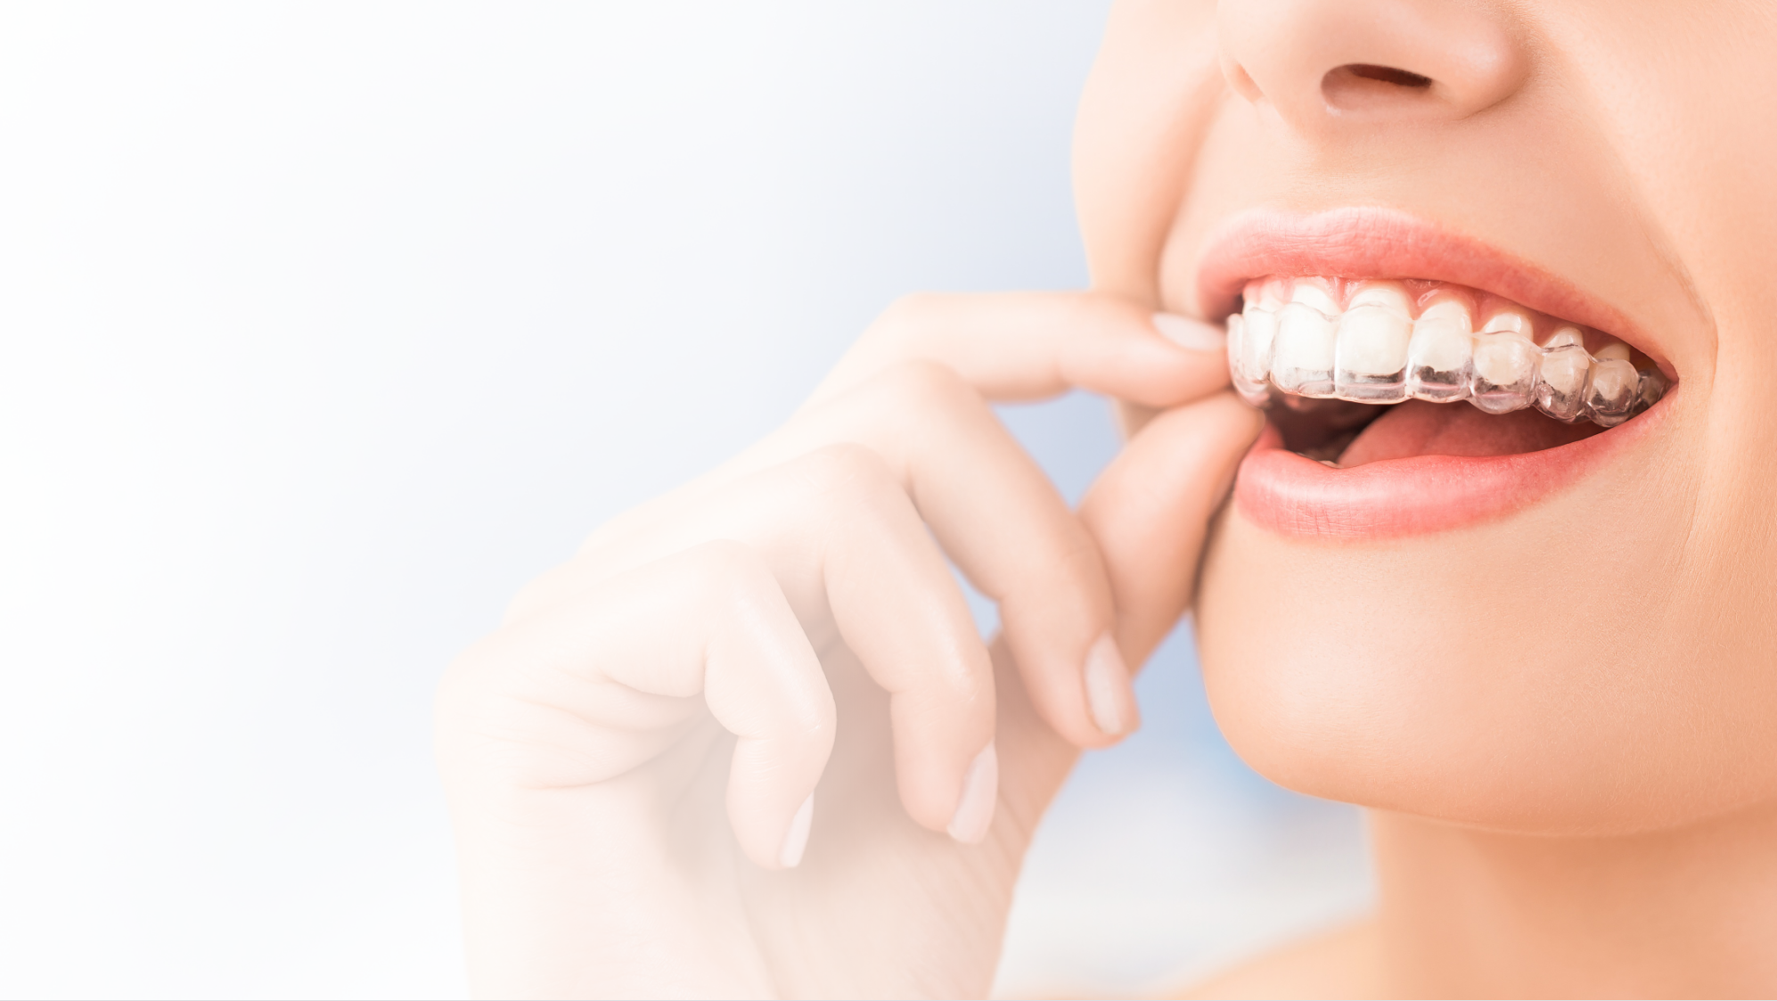
CASE’S Analysis and Design Report
VIVIAN
DATE：2023.10.14

Slide 2
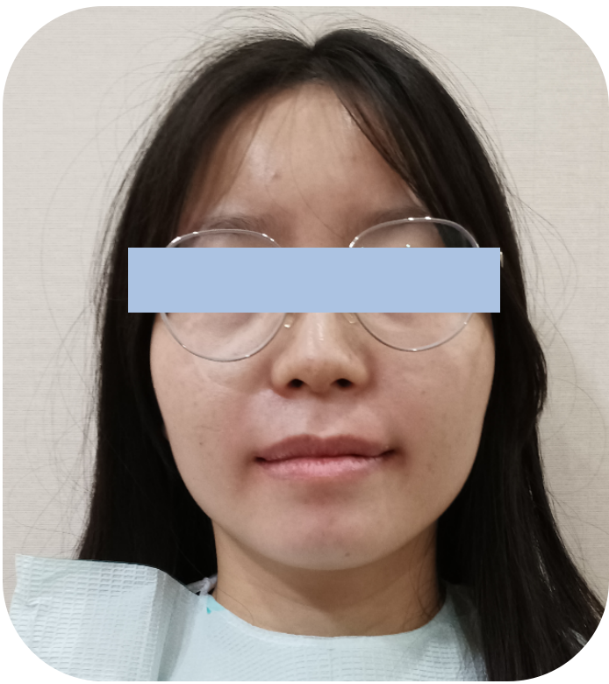
KEY INFORMATION
1· Name：Vivian Age： ** Sex：Female
2· Order：*** ***.
3. Bad habit：****
4· HPI：***
5·Family history：*******

Slide 3
OTHER INFORMATION NEEDED
1· Inquiry：
- Systemic disease
- Bad habit
- Already treatment
- Duration
- Family history 、 psychological guidance
2· Inspection：
- inside check：tooth count、tooth shape 、oral hygiene、dental arch shape 、occlusal status、soft tissue lesions
- outside check ：photograph 、symmetric face、proportion 、overlength lowed 1/3
3. Auxiliary examination：
- Panoramic radiograph examination
- laterral cephlometrics
- CT
4. Other check：
- Model analysis
- TMJ check
- Muscular tension check

Slide 4
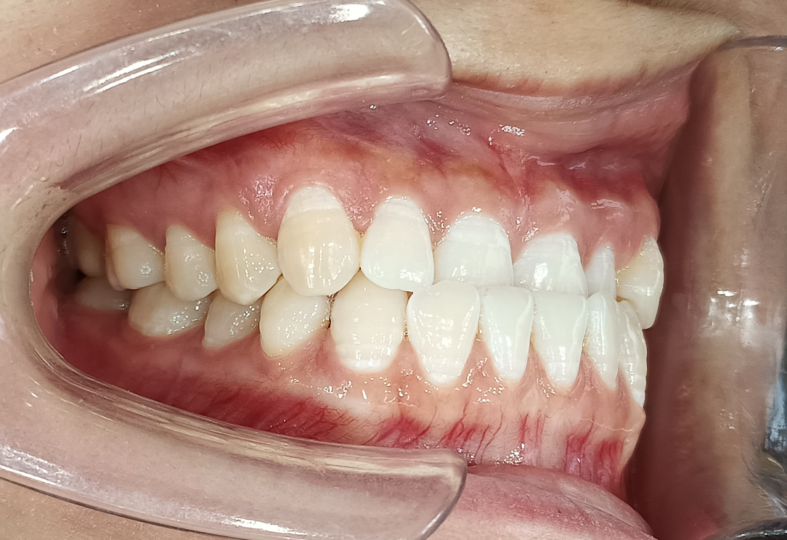
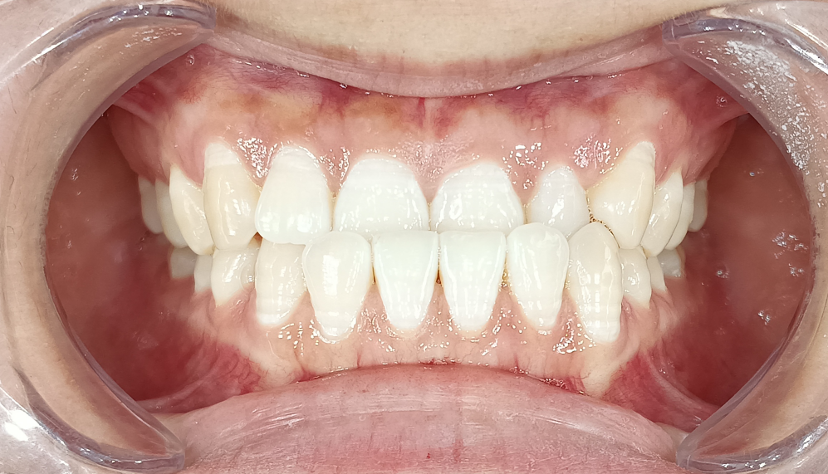
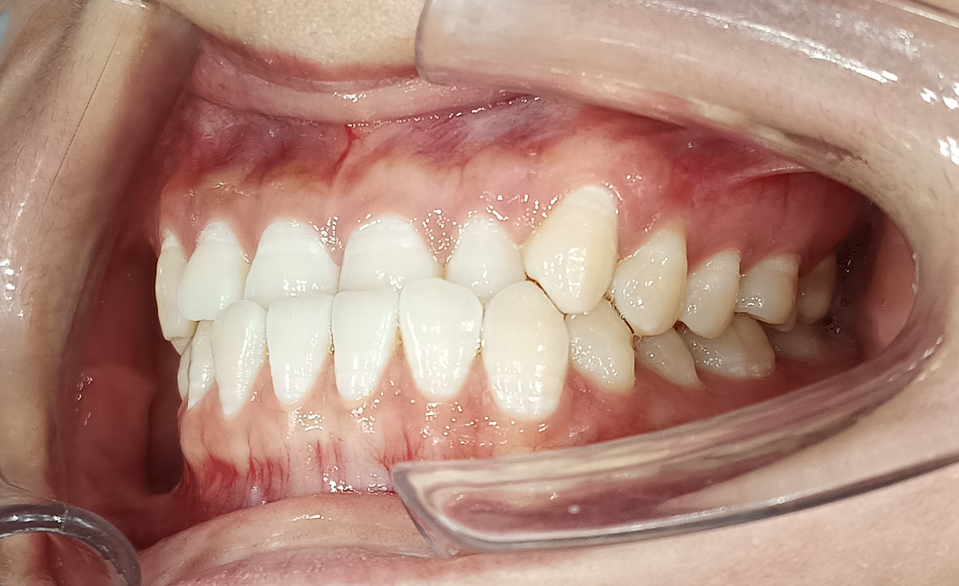
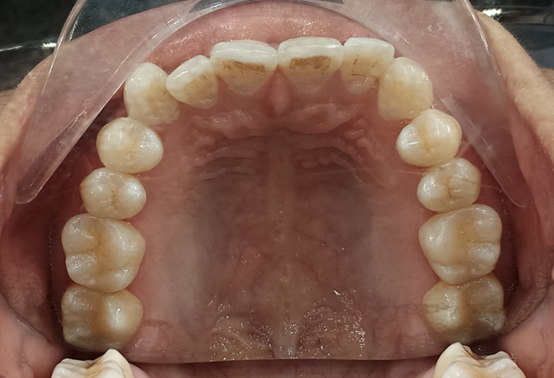
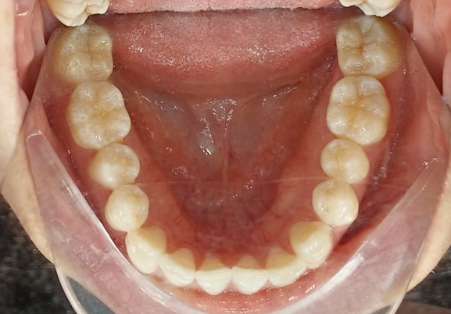
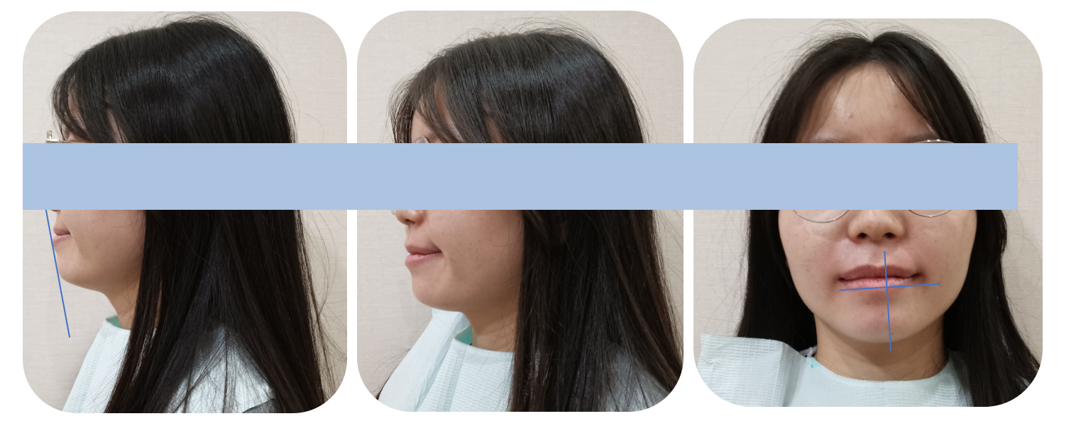
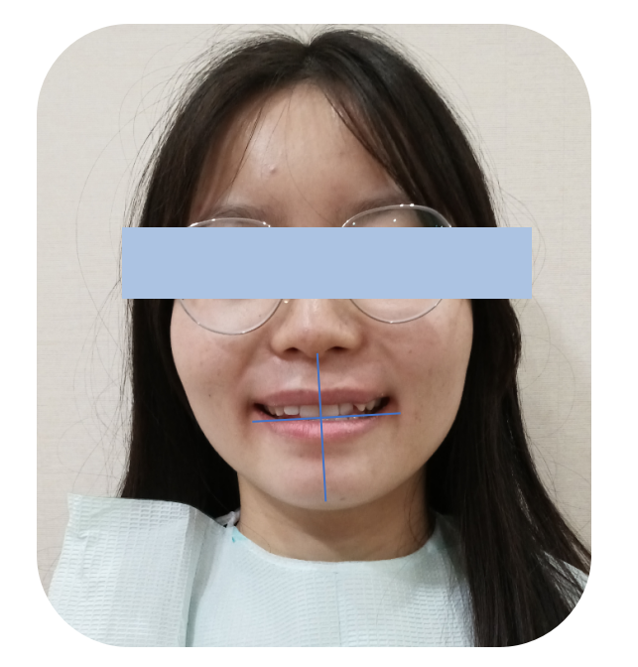
Inside check
Outside check

Slide 5
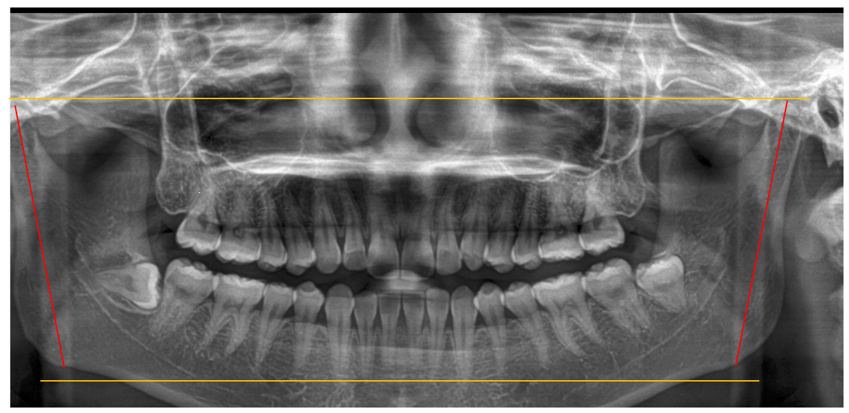
Auxiliary examination
- Panoramic radiograph examination

Slide 6
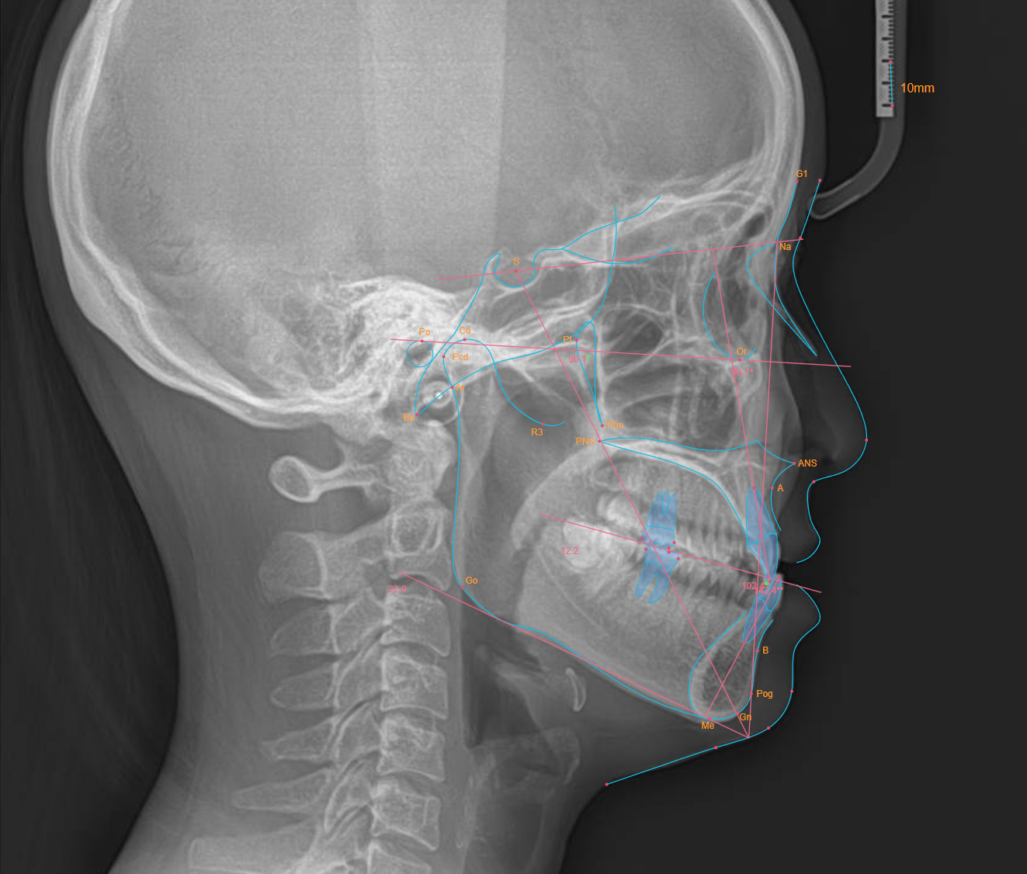
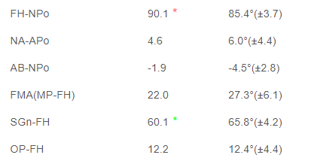
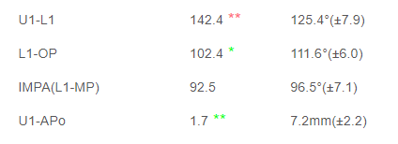
Auxiliary examination
- Laterral cephlometrics

Slide 7
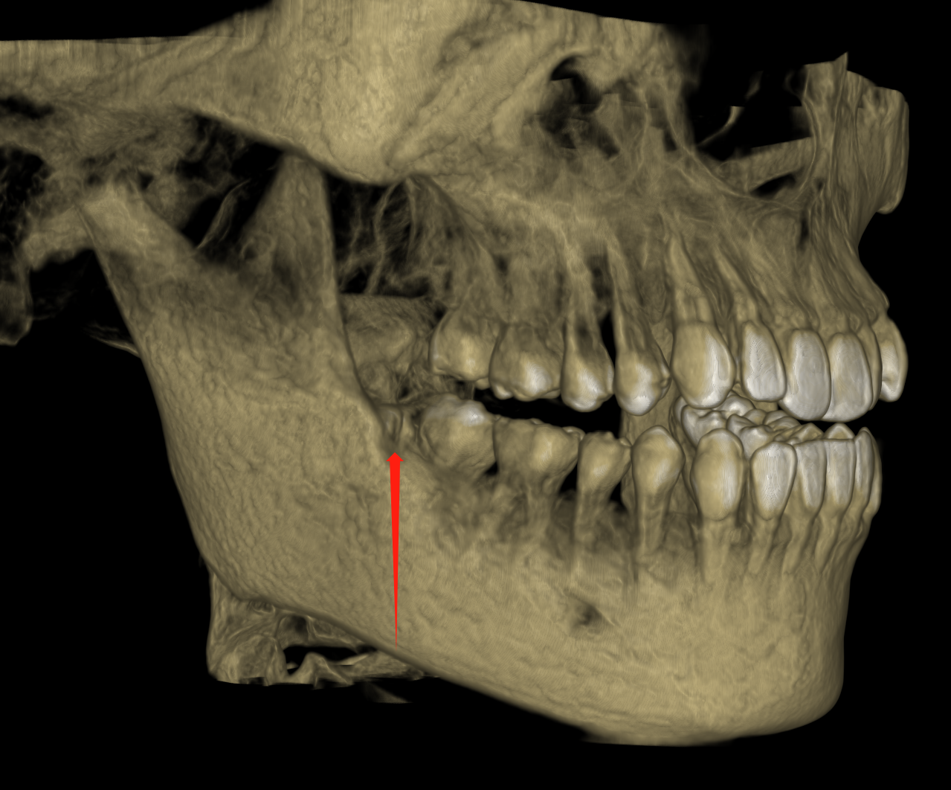
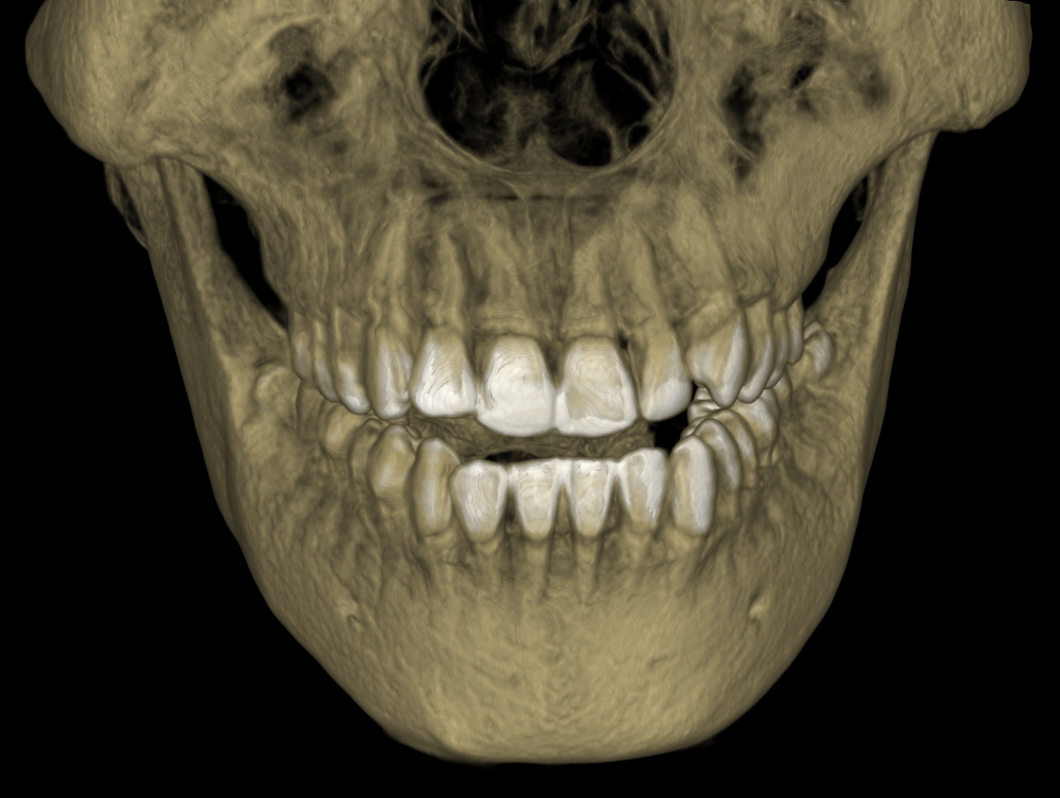
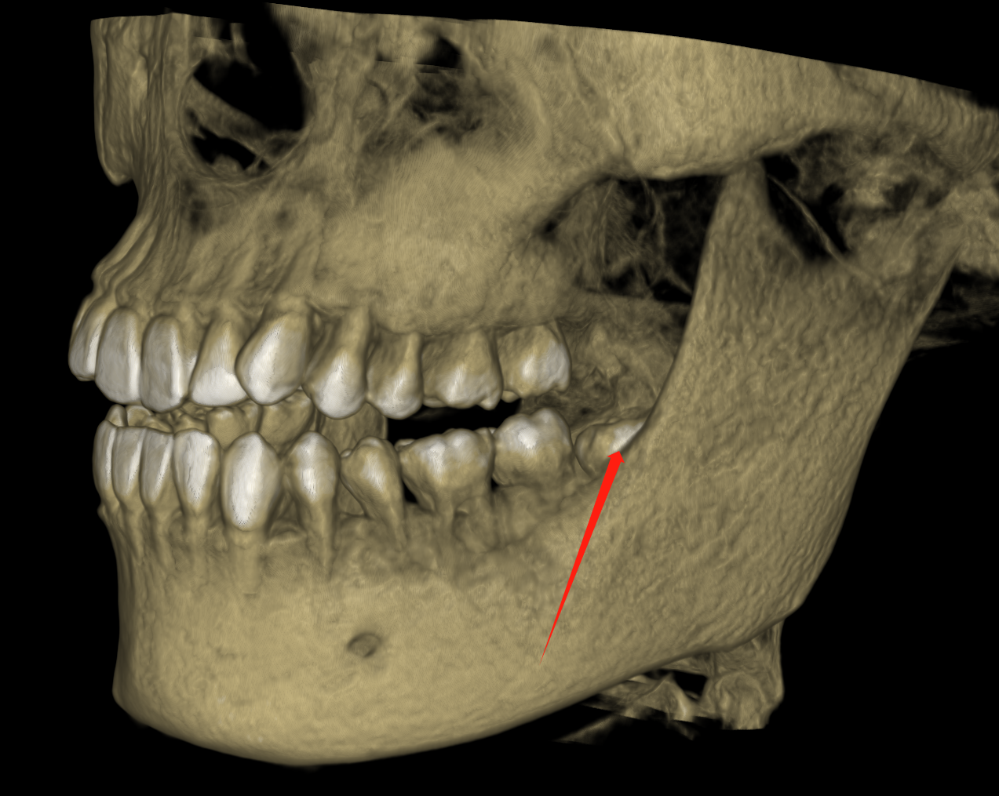
Auxiliary examination
- CBCT

Slide 8
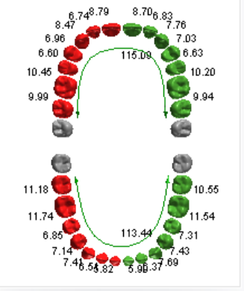
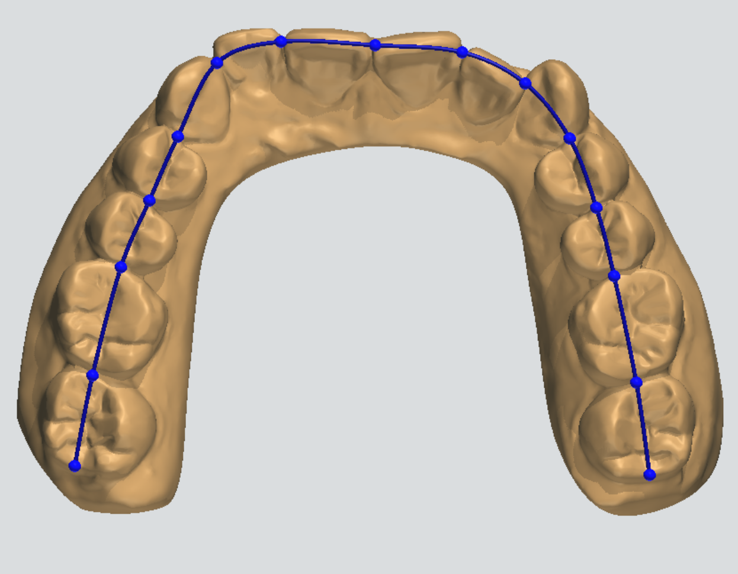
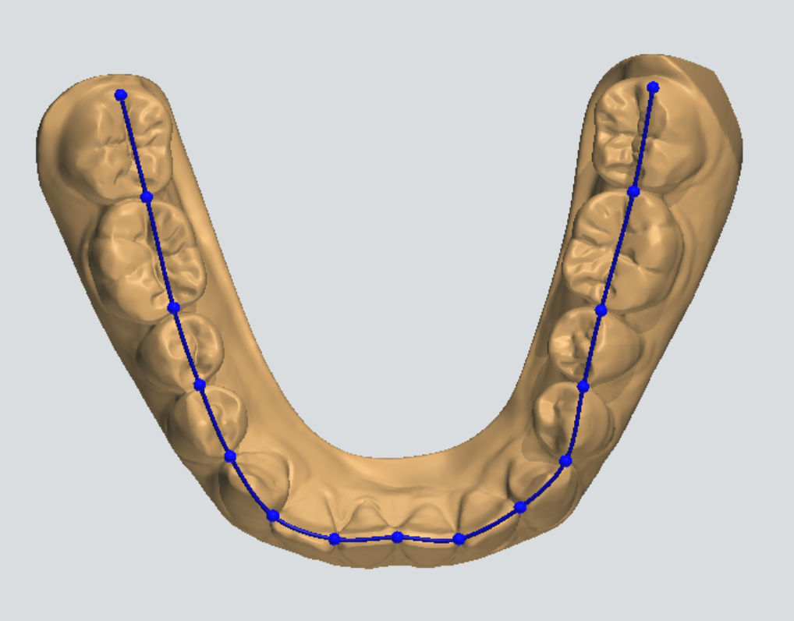
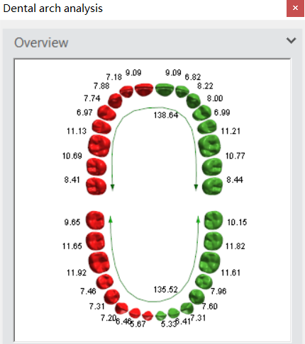
Model Analysis
The current lenght of Maxillary arch ：110.30mm
The current lenght of Mandibular arch ：107.24mm
（Maxillary） amount of crowded in dental arch= 115.09 - 110.30 =4.79mm
（Mandibular ）amount of crowded in dental arch=113.44 - 107.24 = 6.2mm

Slide 9
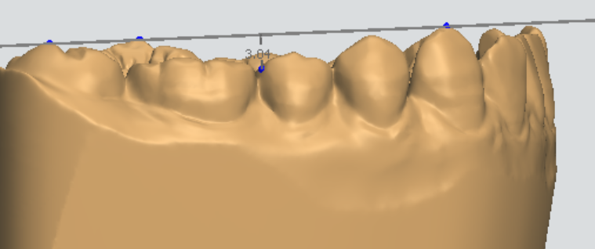
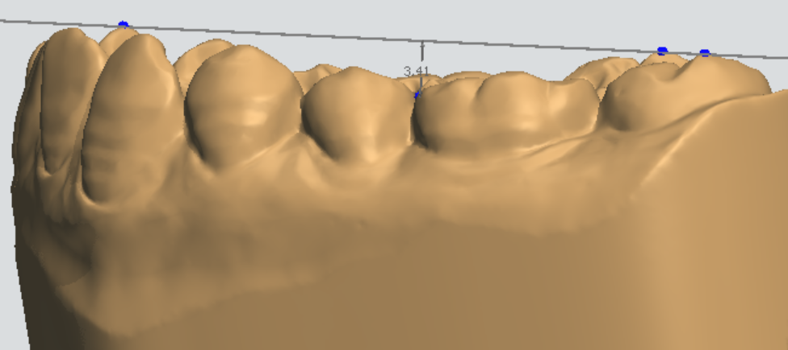
Model Analysis
Cure of spee：（3.04+3.41）/ 2+0.5=3.725mm

Slide 10
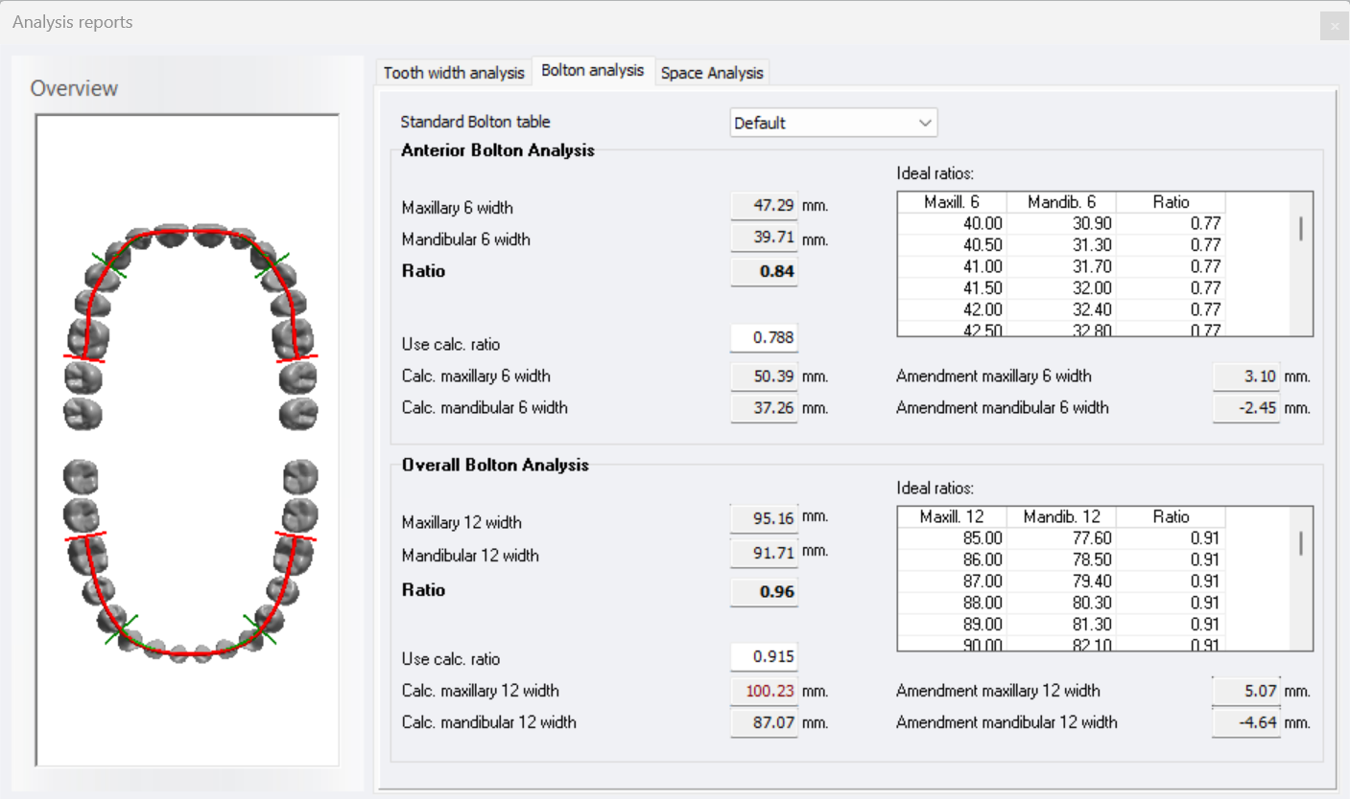
Bolton Analysis
Bolton Index | Normal Value | Measurement Value
Bolton6 | 78.8+1.72% | 84%
Bolton12 | 91.5+1.51% | 96%
颌曲线分析：
Analysis:
The tooth width of the maxillary 3-3 and 6-6 is narrow .

Slide 11
Treatment Plan Description
① 15 steps for upper jaw and 15 steps for lower jaw
② PLip tilted maxillary anterior teeth
③ Mandibular anterior tooth slice cutting to set more lingual side

Slide 12
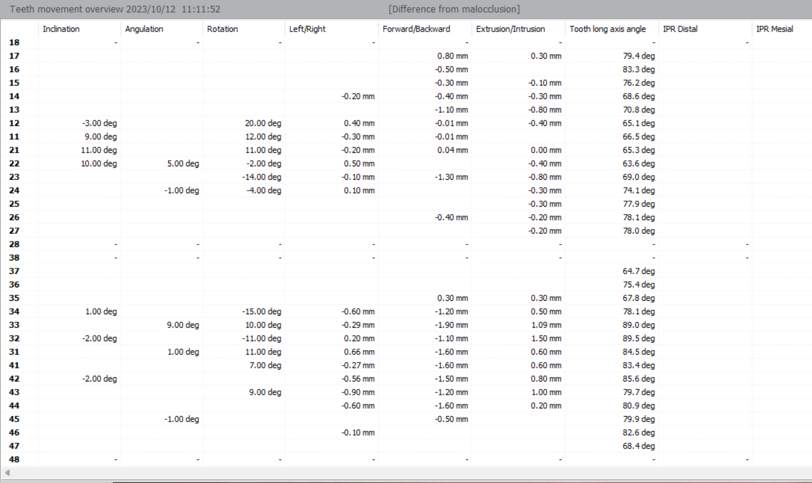
Teeth movements overview—Subsetups count：UPPER 15
LOWER 15
33

Slide 13
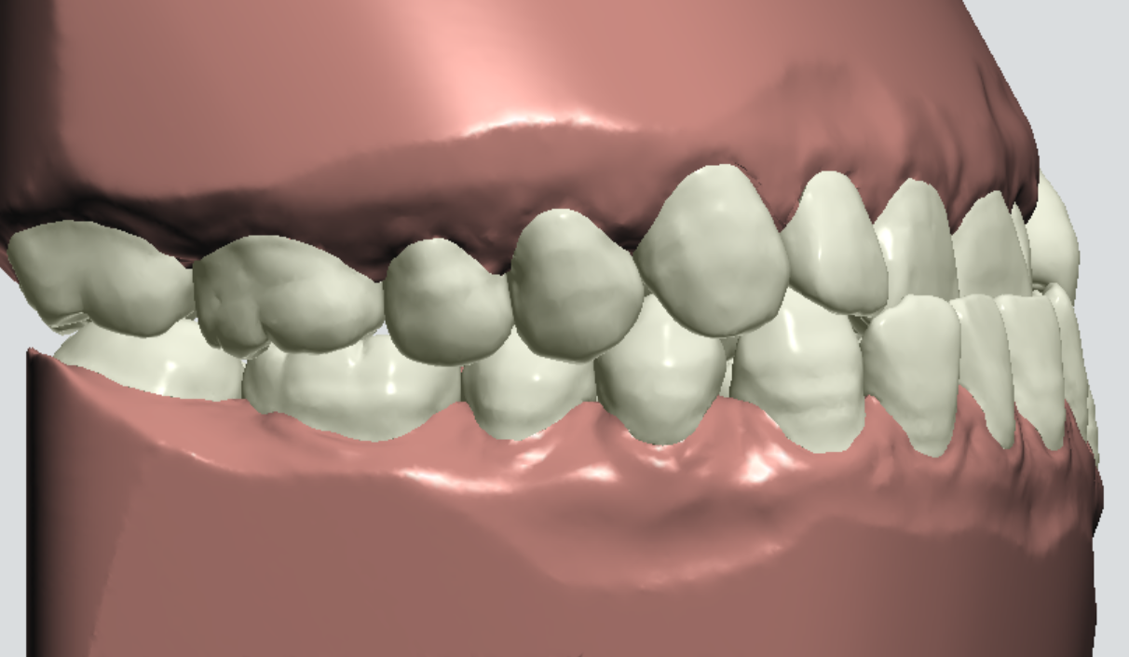
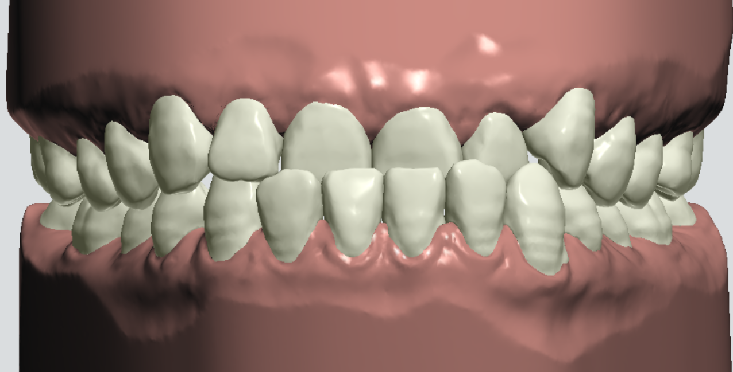
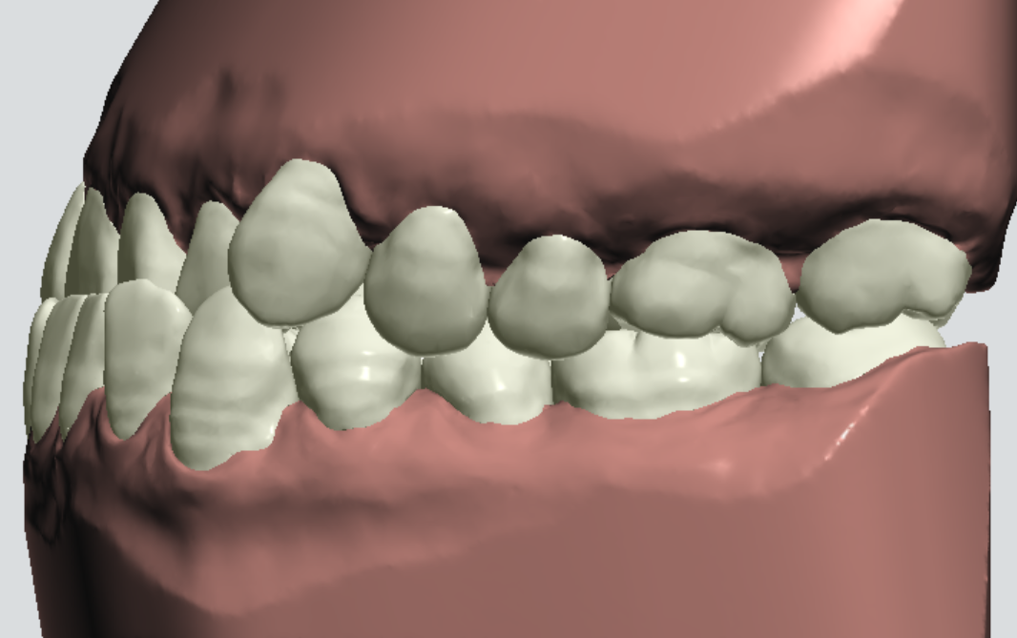
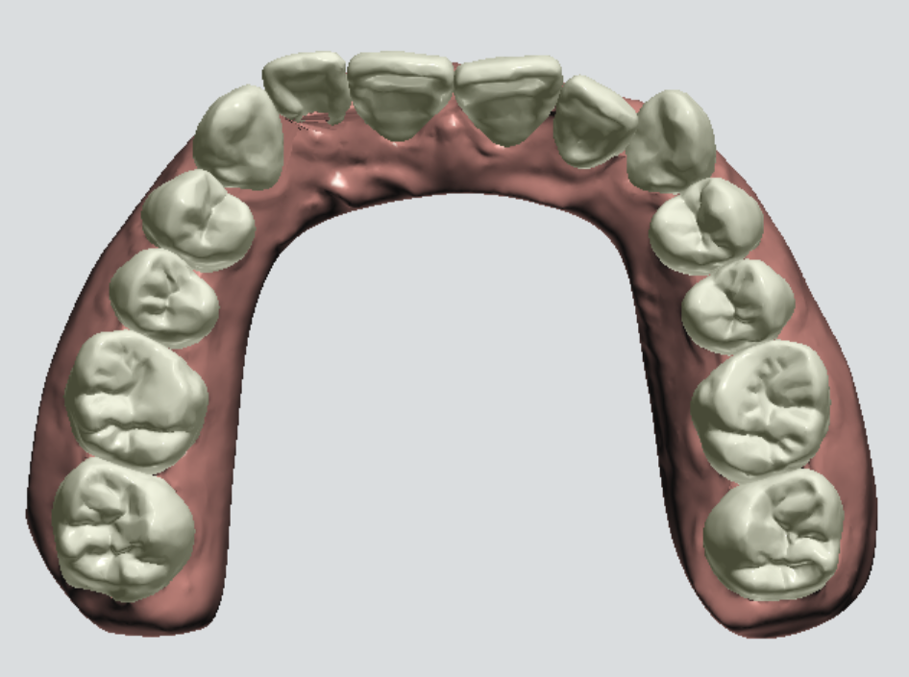
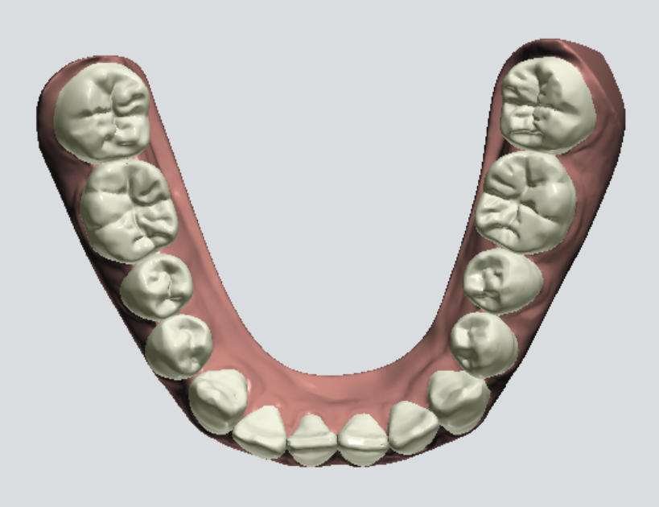
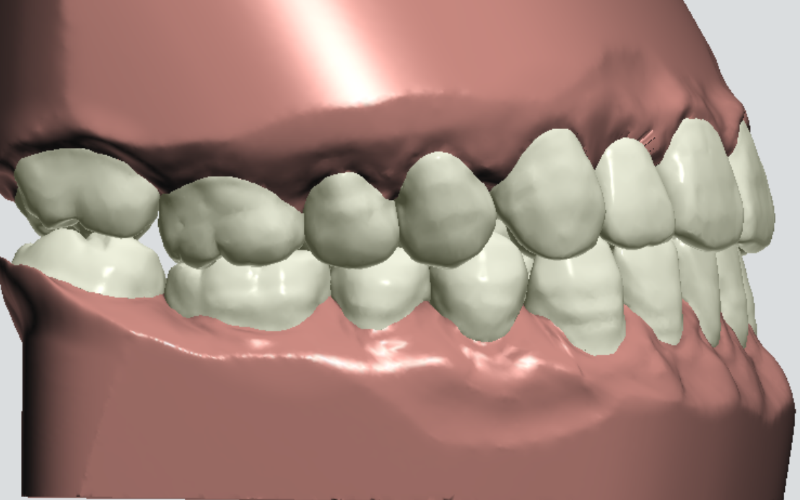
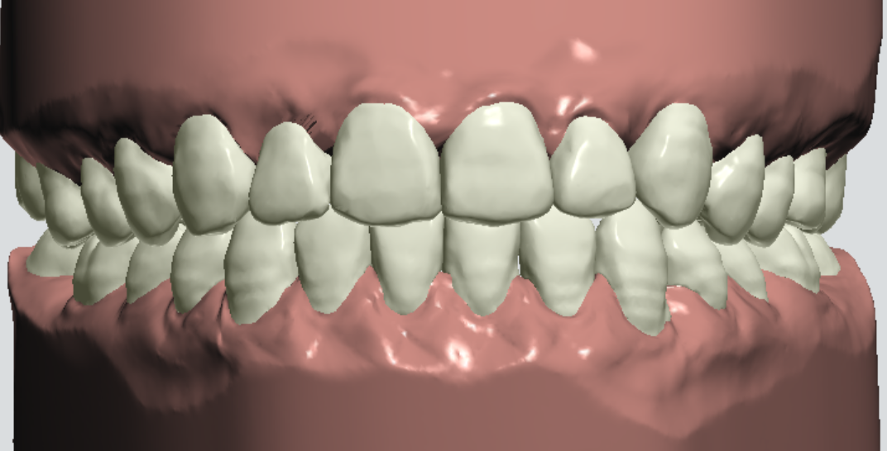
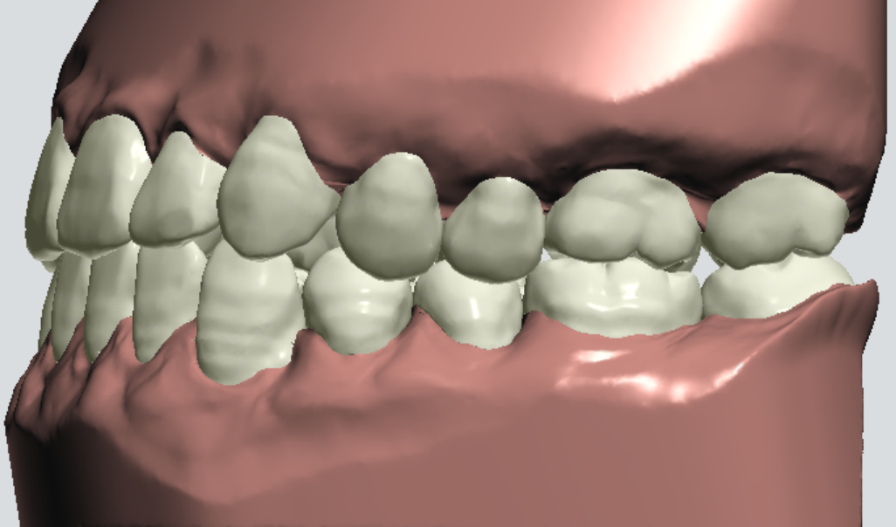
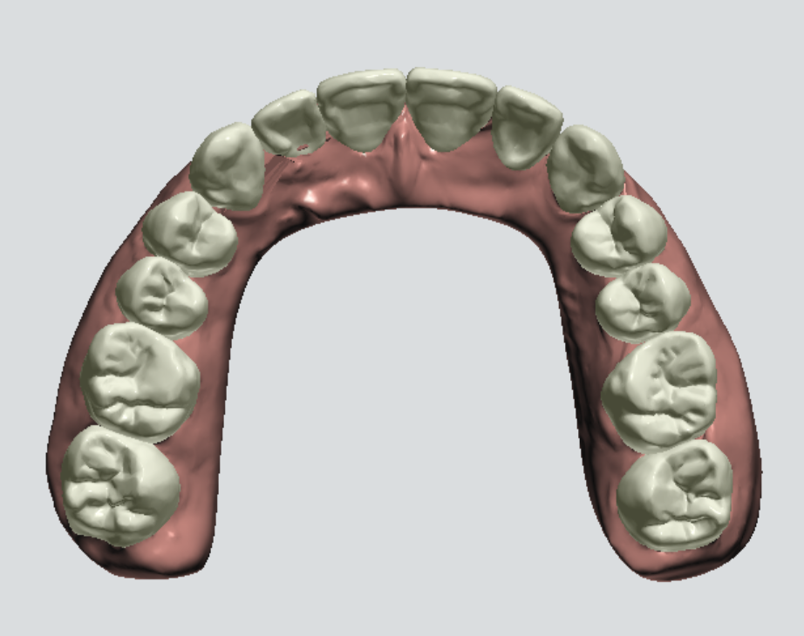
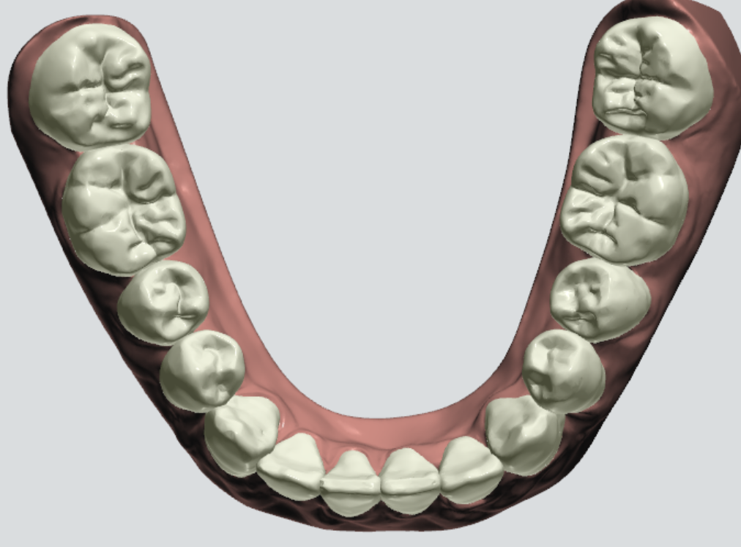
Model set Comparison
Before
After

Slide 14
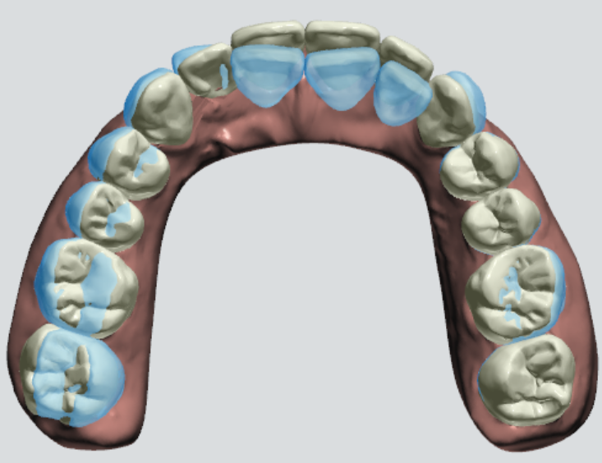
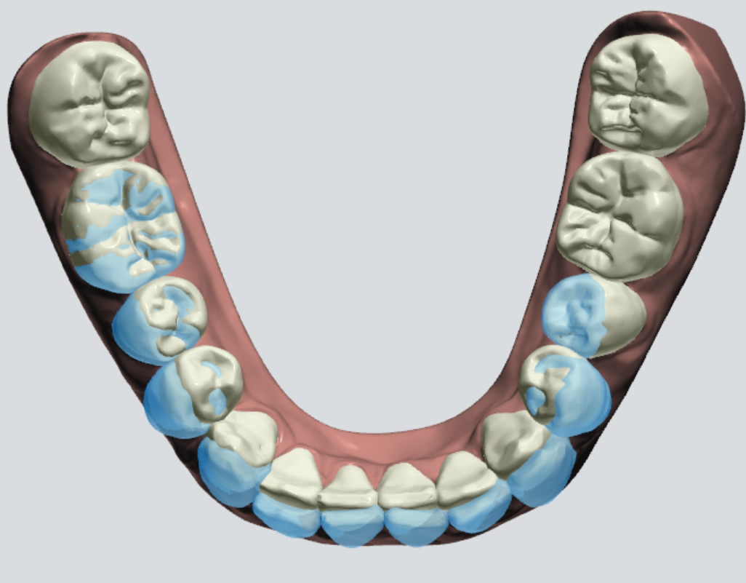
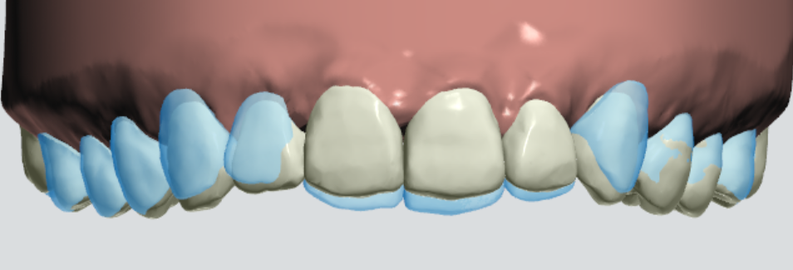
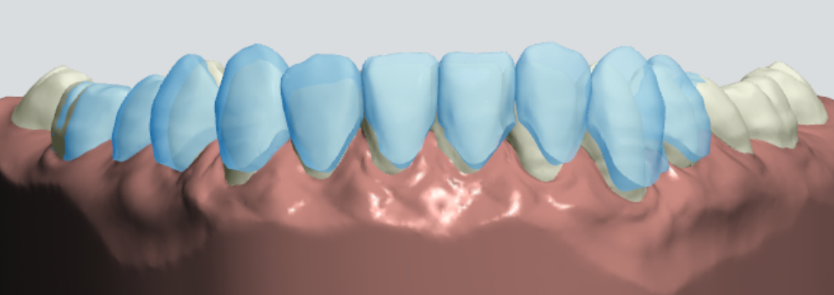
Model set Comparison
24

Slide 15
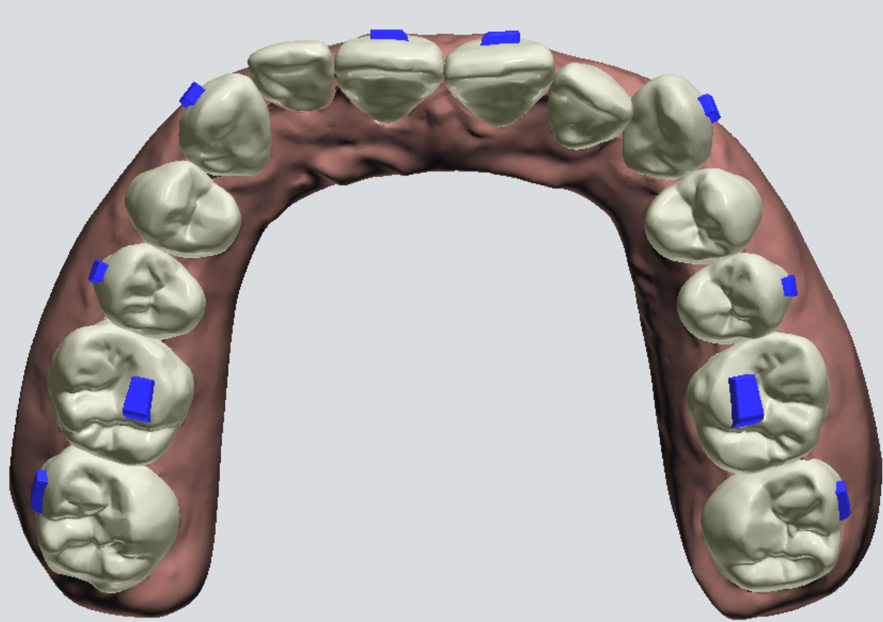
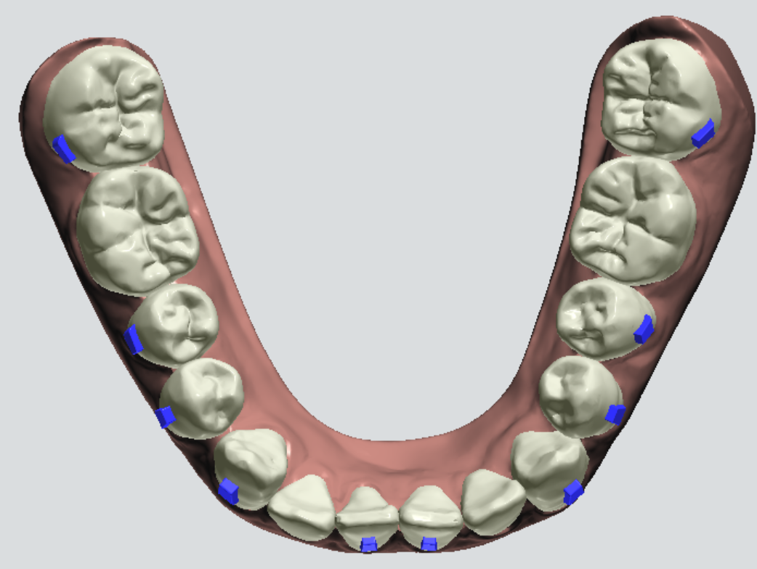
Attachment
24
0 is used as the template.
① 17、15、13、11、21、23、25、27、37、35、34、33、31、41、43、44、45、47 teeth glued with attachment；
② occlusion attachment ：16、26 ，No need for glueing.

Slide 16
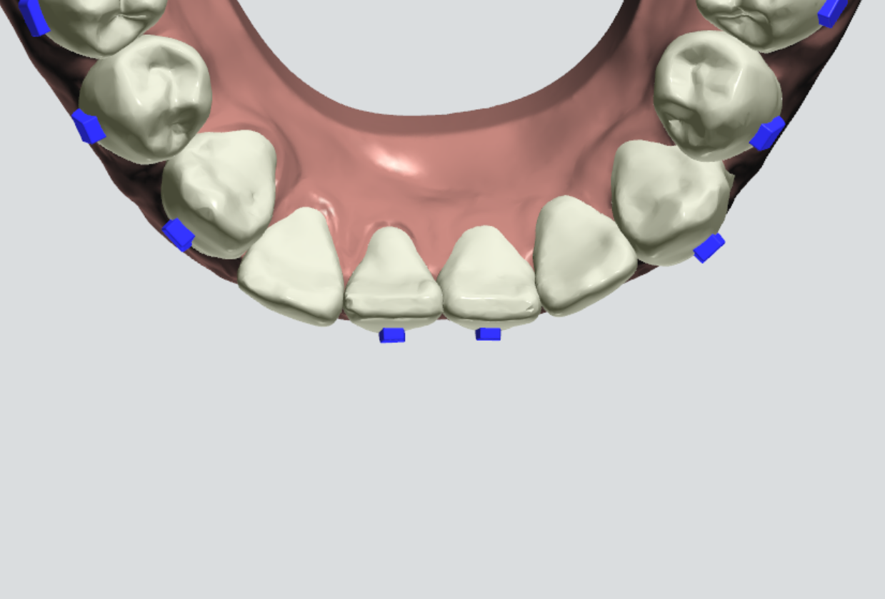
I P R
<7，34-35：0.20mm
<7，44-43：0.50mm
<7，34-33：0.50mm
<7，42-43：0.50mm
<7，32-33：0.50mm
<7，42-41：0.50mm
<7，31-32：0.50mm
<7，31-41：0.50mm

Slide 17
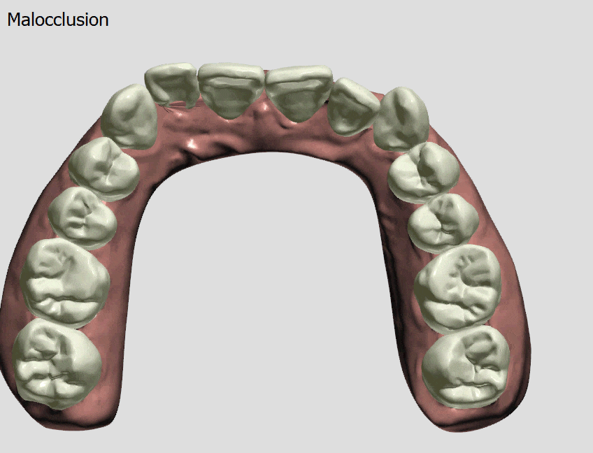
Animations
UPPER 15 Steps

Slide 18
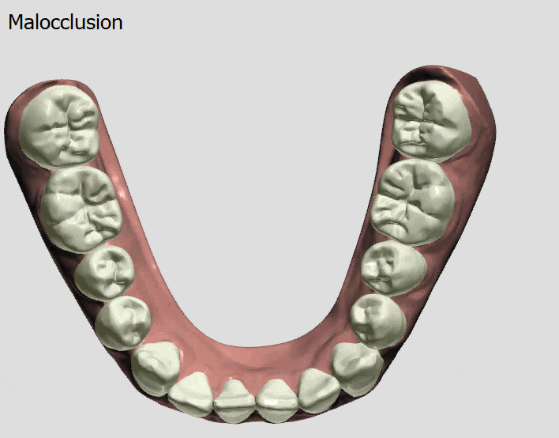
Animations
LOWER 15 Steps

Slide 19
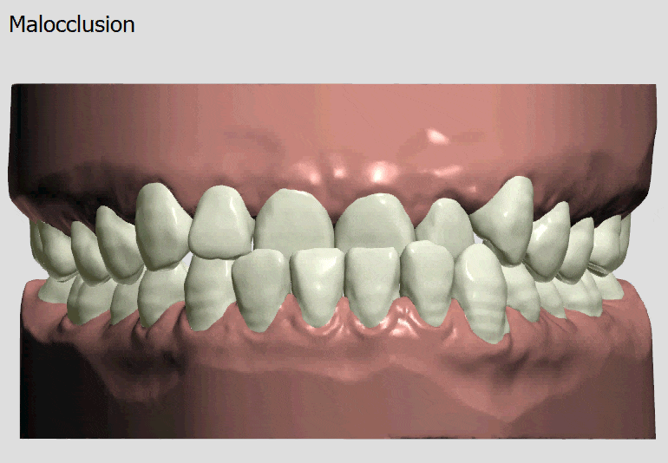
Animations
UPPER 15 Steps
LOWER 15 Steps

Slide 20
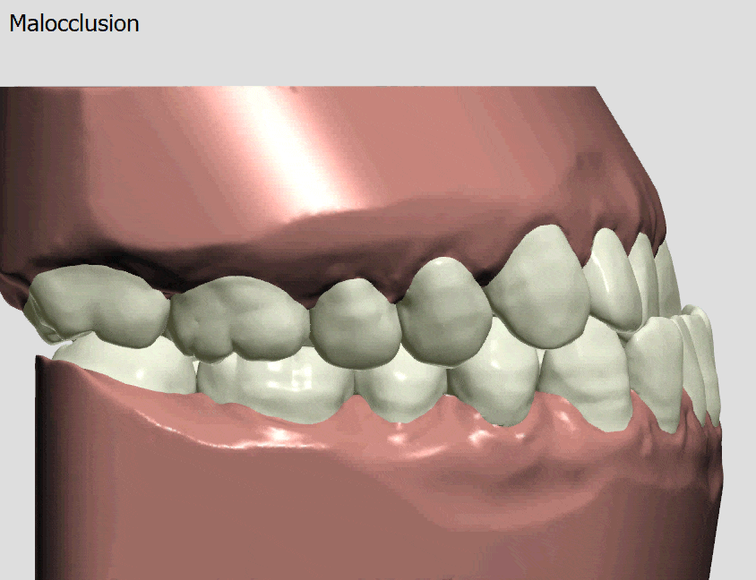
Animations
UPPER 15 Steps
LOWER 15 Steps

Slide 21
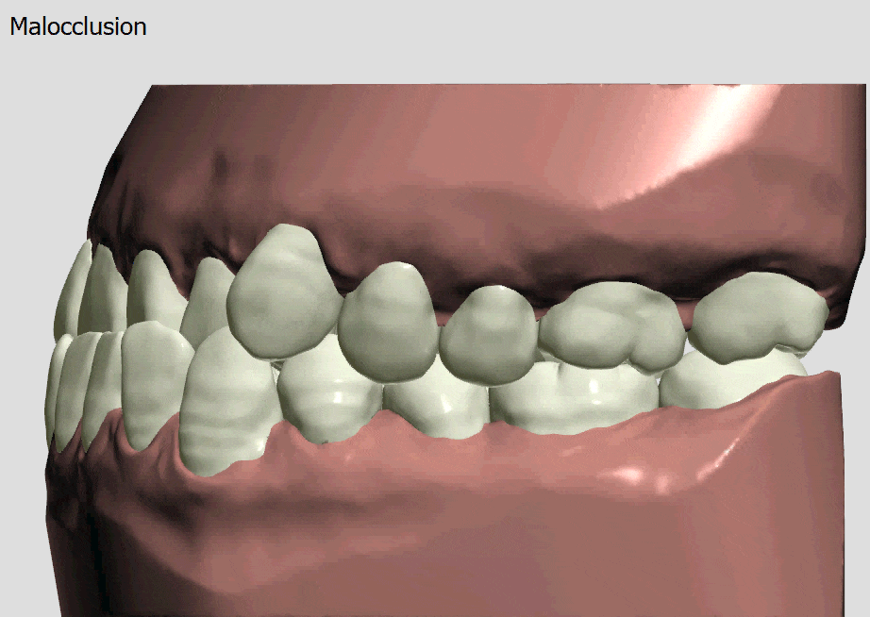
Animations
UPPER 15 Steps
LOWER 15 Steps

Slide 22
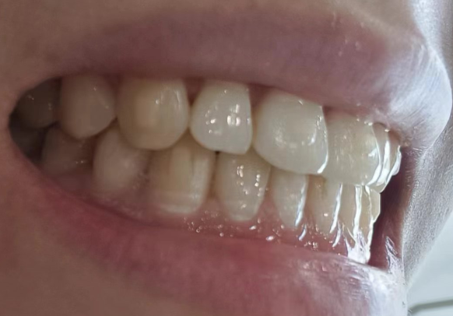
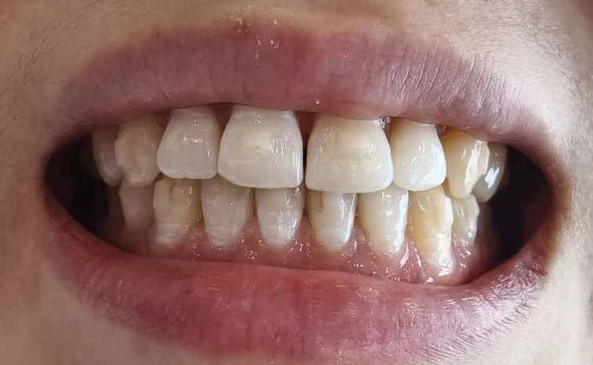
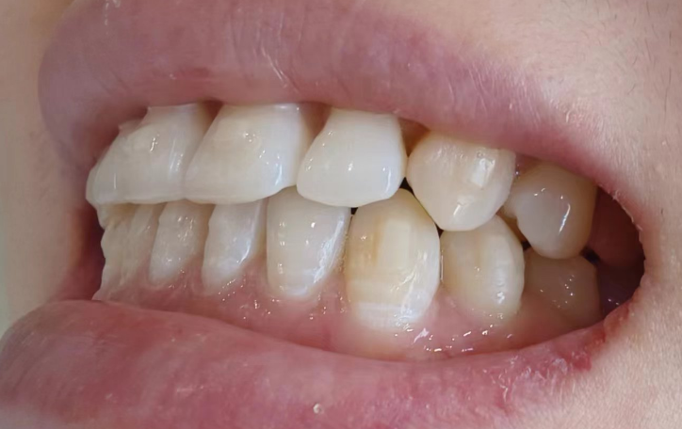
BEFORE & AFTER
Before 10/2023
After 03/2024

Slide 23


Technology makes your smile more confident.

